Slide 1
Advanced N-mixture Models

Slide 2
Distributions for N
Poisson Distribution is common for count data but other distributions available
Zero-inflated Poisson
Negative Binomial

Slide 3
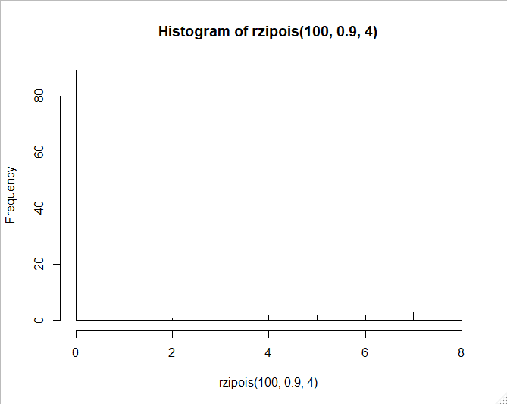
Zero-Inflated Poisson
Another layer added to hierarchical model
1st layer now accounts for extra 0s in dataset
Can be thought of as “suitability” of habitat/site
2nd layer typical Poisson distribution

Slide 4
Negative Binomial
Overdispersion
Variance large relative to the mean
Negative Binomial has 2 parameters to model giving it more flexibility
Some indications that may not produce valid results in unmarked

Slide 5
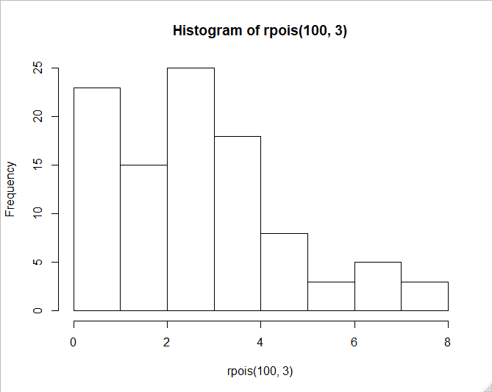
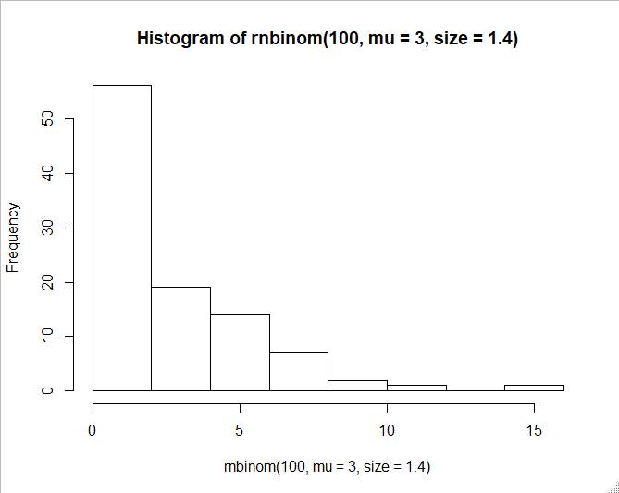
Poisson vs. Negative Binomial

Slide 6
Goodness-of-Fit Statistics
Test of how well the data fit your model
R function uses Pearson’s chi-square test and bootstrapping
Null hypothesis is that data fit, so “fits” if p > 0.05

Slide 7
Model Selection
Can compare models using AIC
Can compare both different covariates of interest as well as distributions (Poisson vs. zero-inflated Poisson)

Slide 8
Different Types of Survey Data
Removal data
Double observers
Open N-mixture models

Slide 9



Different Types of Survey Data
Removal data
For birds, only counting new birds heard during point count
Min 1-3
Min 4-6
Min 7-9
Min 9-11

Slide 10
Different Types of Survey Data
Removal data
For birds, only counting new birds heard during point count
Min 1-3
Min 4-6
Min 7-9
Min 9-11
Encounter history: 2010

Slide 11
Multinomial Detection Probabilities
Observation model is multinomial for removal sampling
We instead of removal frequencies for each sampling period
π₁ = p
π₂ = (1-p)p
π₃ = (1-p)²p
π₄ = (1-p)³p

Slide 12
Multinomial Detection Probabilities
Double observer sampling also uses multinomial probabilities

Slide 13
Random Effects in N-mixture Models
We can include random effects in N-mixture models as well
Could be for detection probability or abundance
Can’t be done in unmarked! Instead have to use package ‘umbs’

Slide 14
Package umbs
umbs uses Bayesian statistics to calculate N-mixture models
Runs STAN in the background through R
Different notation from unmarked but similar to GLMM and lmer code

